Slide 1
Mantid Mslice Design Overview
Steve Miller
June 23, 2014
Walking through a prototype MSlice application

Slide 2
Summary Overview
The prototype Mantid MSlice GUI application presented here follows patterns and provides features similar to previous versions of MSlice so the application is intended to be user intuitive.
The new application takes advantage of:
Mantid data load and processing algorithms
Mantid workspace data model
Mantid data visualization where possible
New data visualization developed as necessary
Saving of processed workspaces enables the user to re-use this data directly
The application has been divided into three functional areas:
Workspace Manager – to support application data management
Calculate Projections – employ Mantid algorithms
Visualize Data – utilize Mantid and Matplotlib for data visualization
Initial support is for calculating projections of Powder data with Single Crystal data support to follow later.
The application is being written using PyQt

Slide 3
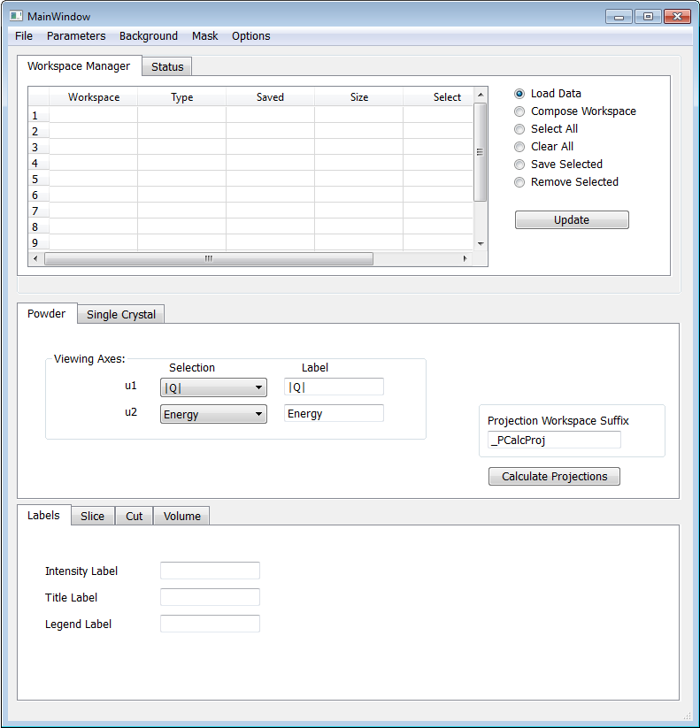
Mantid Mslice Main GUI – Powder View
Initial view of a prototype MSlice main GUI illustrating the three functional areas of the user interface (Top, Middle, Bottom):
Top enables:
Loading of data workspaces
Launching an integrated but separate Workspace Composer application (discussed later)
Checking and clearing of workspace selection status
Saving workspaces to file
Removing selected workspaces from the application
Middle:
Powder/Single crystal tab selectable
Workspace suffix can be modified by the user
Workspaces created here are made available via the Workspace Manager
Bottom:
Data visualization tabs for slices, cuts, and data volume (single crystal only)
Visualization tools will be separate but integrated applications

Slide 4
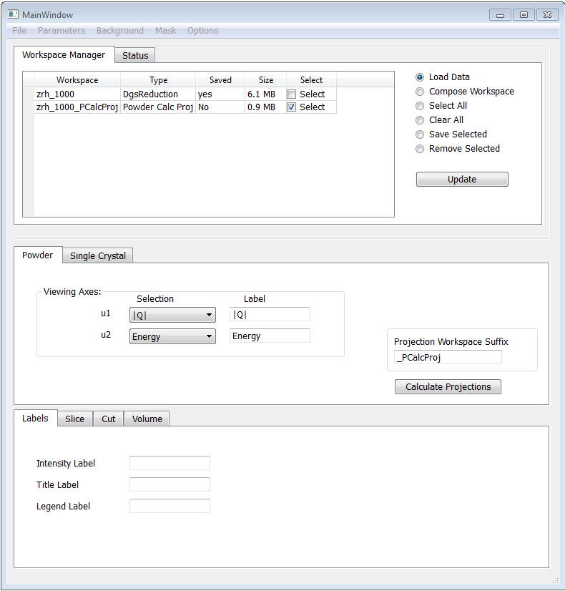
Load and Calculate Powder Projection
Basic use case for Powder data:
WM: Load data
Powder: Calculate Projections using either the default or user modified workspace suffix
WM: Provide the newly created projection workspace entry back to the workspace manager as there the workspace could be saved to file and loaded later.
WM: Automatically update deselecting and selecting of workspaces according to the workflow – here the original workspace has been deselected while the new powder projection workspace has been selected
DV: Utilize corresponding data visualization tools
DV and Powder: Pre-specify labels and data visualization ranges propagated to the visualization tools
(WM – workspace manager, Powder – Powder Calculate Projections tab, DV – Data Visualization)

Slide 5
Data Visualization
Overview provided here for the next three slides:
Slide 1 – Plot Cut:
Select from the ‘Cut’ tab and pops-up a separate PyQt plot tool with embedded Matplotlib functionality
Copies over labels and parameters from the main GUI to the plot tool
Enables user to change labels, region selection and summation parameters, and to annotate the plot
Slide 2 – Pop-out Plot:
Once a plot is to a useful point, it can be “popped out” as a static plot for subsequent use as a basic Matplotlib figure
Additional pop-out plots can be created as desired
Enables the user to continue using the plot tool to create new views of the data without losing prior work performed
Slide 3 – Slice Viewer:
2D data visualization of the powder data
Leverage the existing Mantid Slice Viewer which includes a plot slice tool

Slide 6
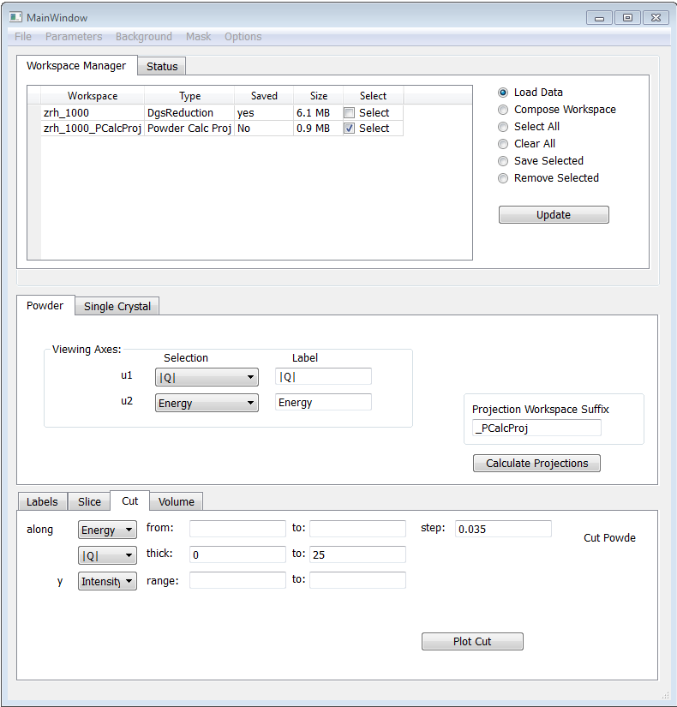
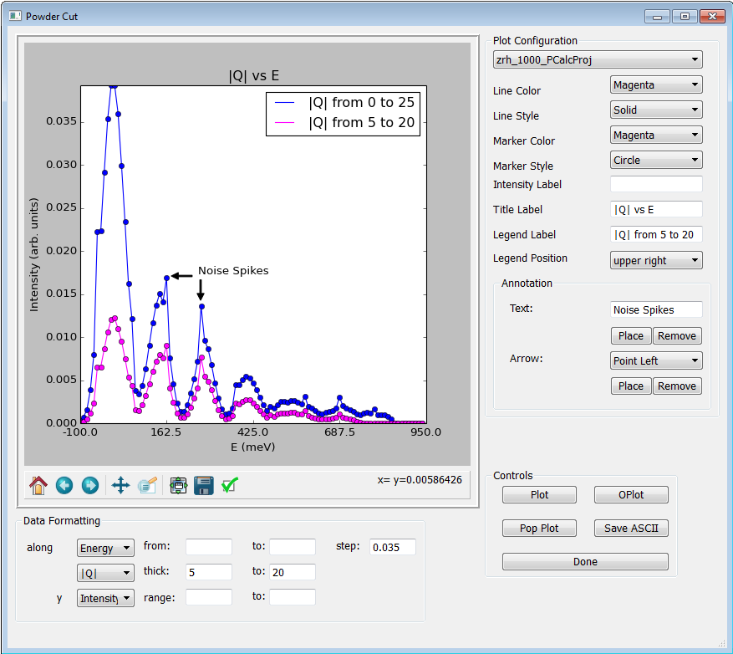
Powder Plot Cut

Slide 7
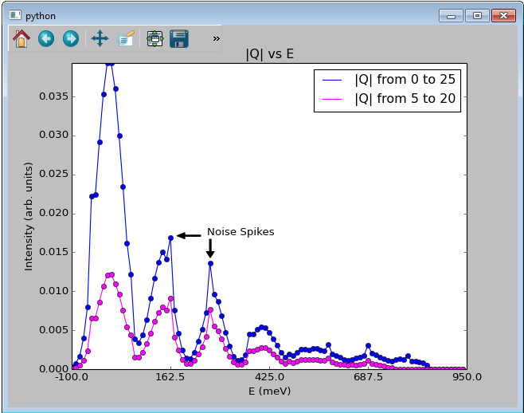
Pop-out Plot

Slide 8
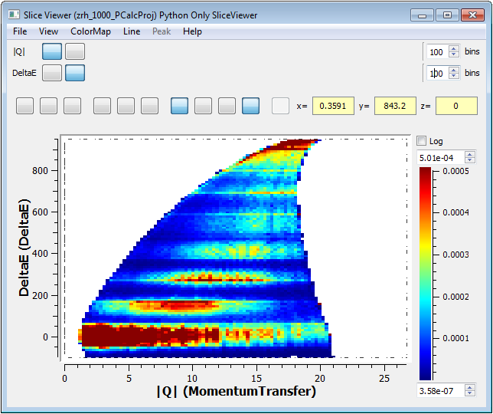
Mantid Slice Viewer Incorporated
Significant functionality already available within the existing Mantid SliceViewer application:
Color bar selection
Rebinning and bin size selection
Plot slice tool built in
More…
The SliceViewer may be the only existing MantidPlot visualization tool which can be directly incorporated within this MSlice application
Button icons have somehow disappeared during MSlice integration – need help figuring this out…

Slide 9
Workspace Composer
Next three slides describe the Workspace Composer:
Group Workspaces: a set of files either provided by the Workspace Manager or via the Workspace Composer can be grouped into a group workspace
Sum Workspaces: the selected workspaces listed in the composer can be summed into a new workspace then made available via the Workspace Manager for subsequent use
Workspace Algebra: composer workspaces can be used in simple equations, and saved and used via the Workspace Manager

Slide 10
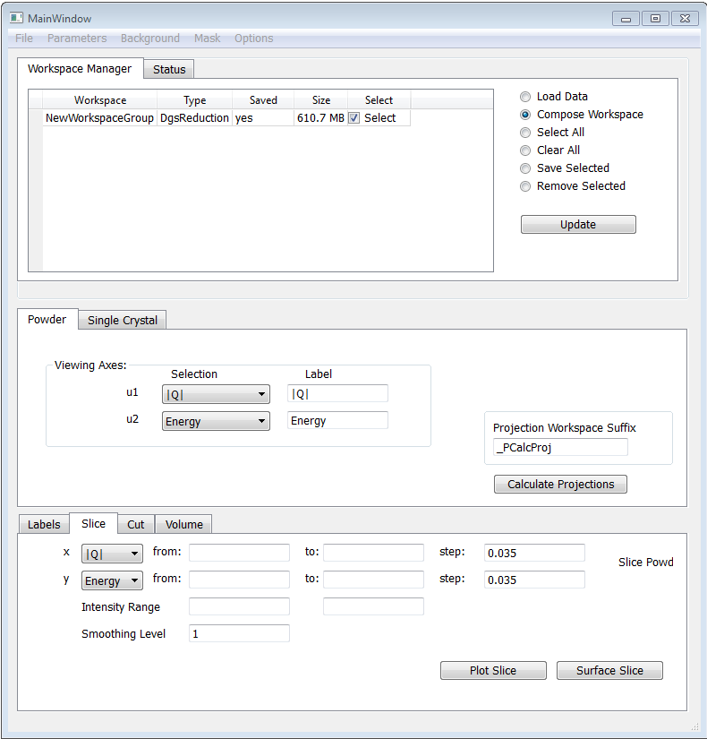
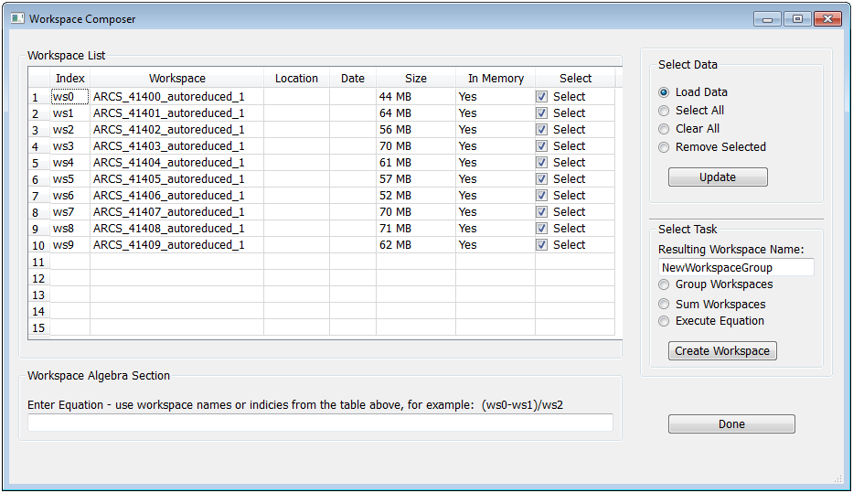
Workspace Composer: Group Workspaces

Slide 11
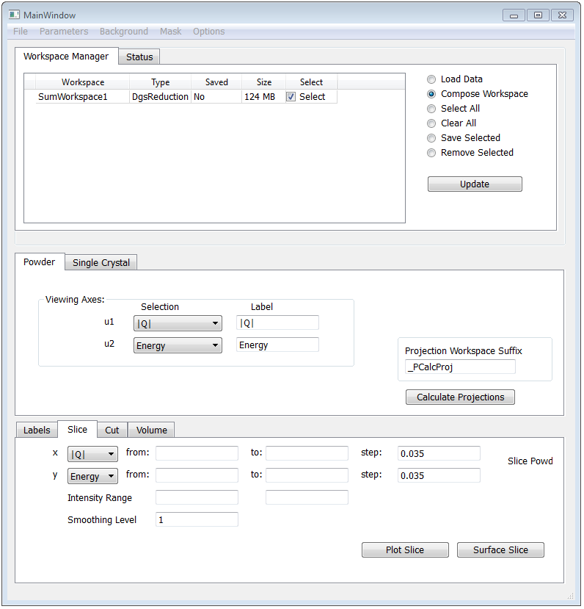
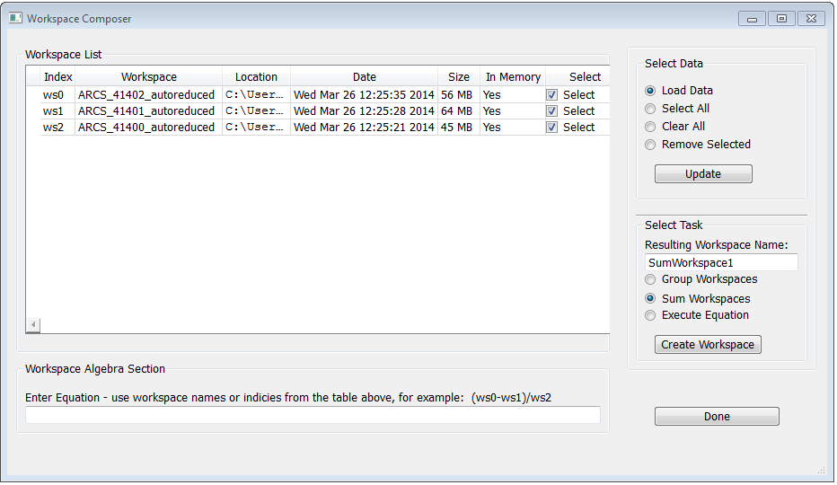
Workspace Composer: Sum Workspaces

Slide 12
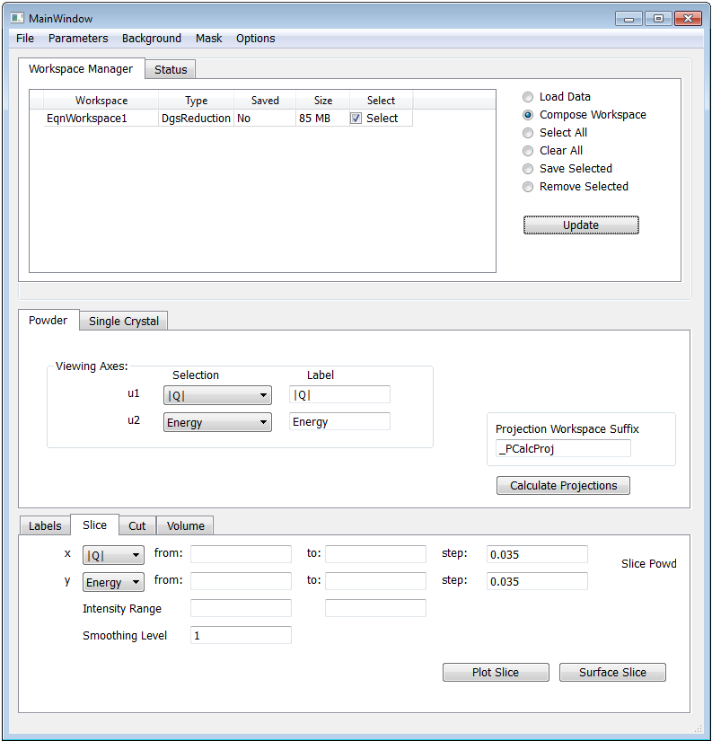
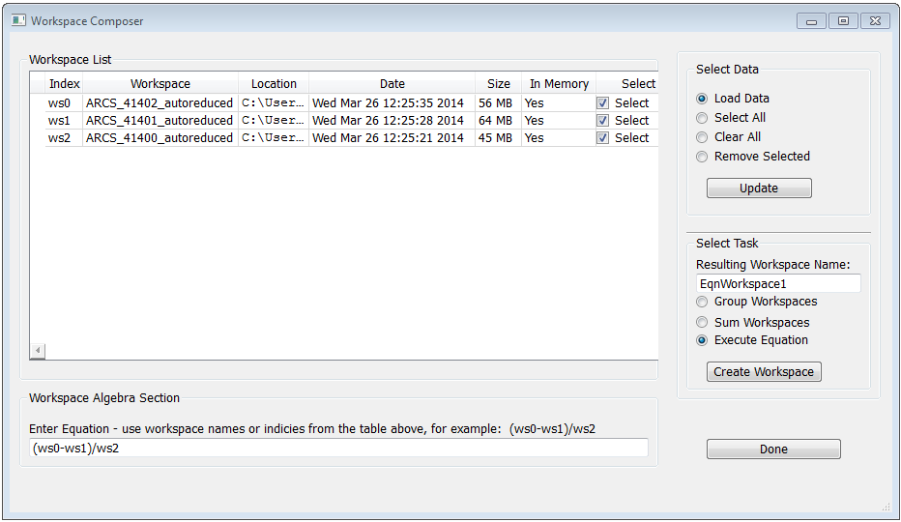
Workspace Composer: Workspace Algebra

Slide 13
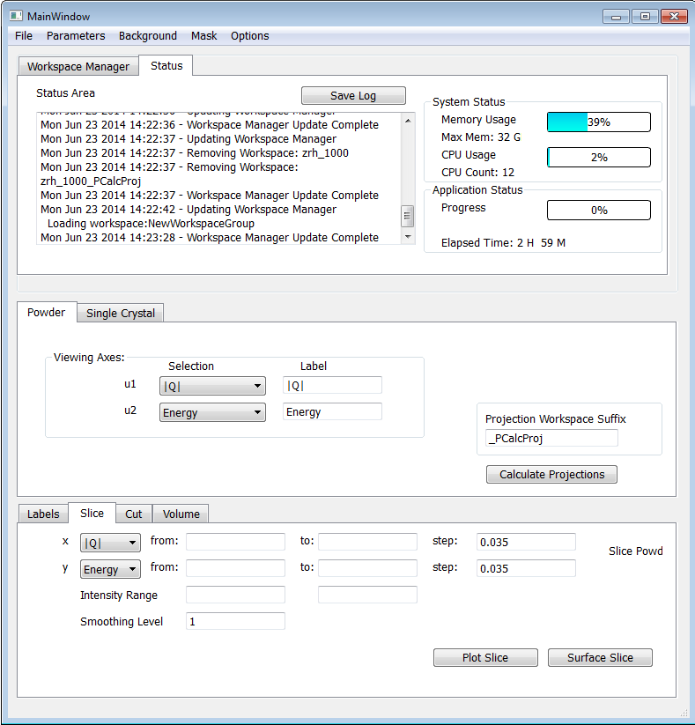
Status View
A Status view tab is provided alongside the Workspace Manager tab
Relevant information can be placed into the log area by the application where the user can save out the log file
Bar graphs provide the system status feedback to the user for % memory and CPU usage
An application status bar provides task % complete feedback
The elapsed time since the application was launched is also provided

Slide 14
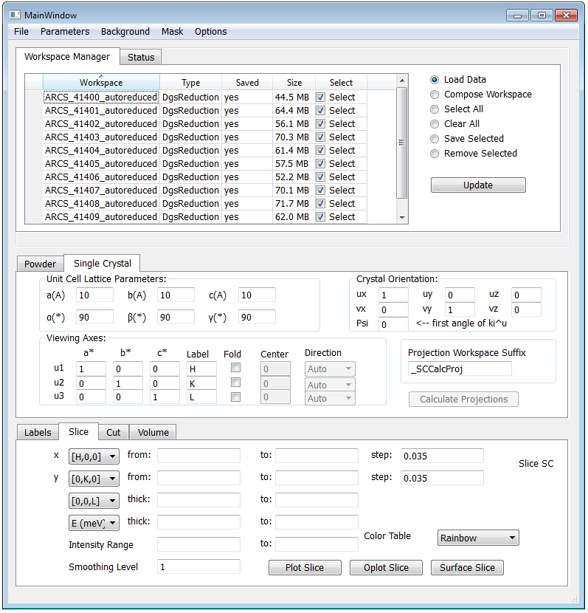
Single Crystal GUI
Enables the user to load either a list of workspaces, or a group workspace – here a list of workspaces is shown
Projected workspaces will be made available via the Workspace Manager for subsequent use
The user selects the parameters to create a projection
The user selects the parameter range for data visualization
Currently this UI is a placeholder for supporting single crystal data analysis

Slide 15
Current Status
A prototype application is in the process of being developed:
It utilizes python/PyQt4 and calls Mantid data load and processing algorithms
Initial implementation only for the powder sample case and currently only support for |Q| v E within powder processing is available.
Plots utilizing Matplotlib or SliceView (SV extracted from MantidPlot)
Processing and plotting supports multiple workspace selection which enables users to work concurrently with sets of workspaces known as a workspace group
Much work remains to be done but the application is functional enough to demonstrate concepts and solicit feedback

